Slide 1

Visualization of Incidents Reports in tableau

Slide 2
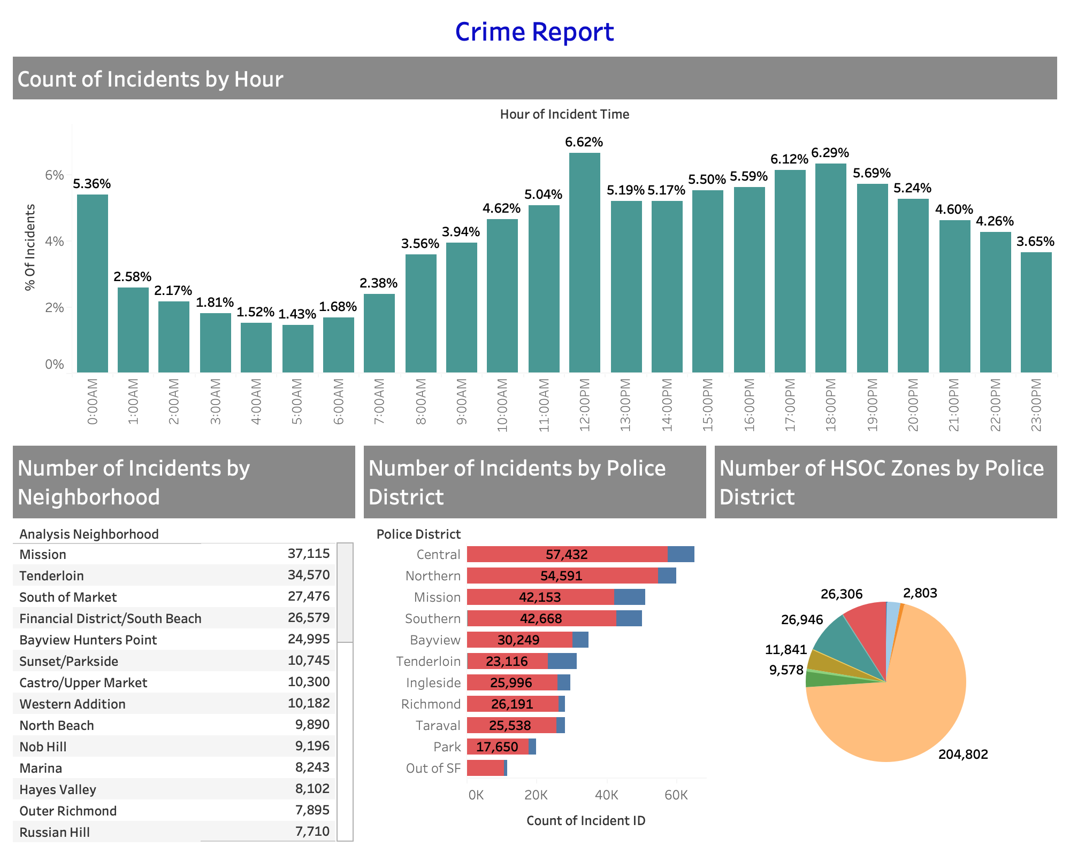

Slide 3
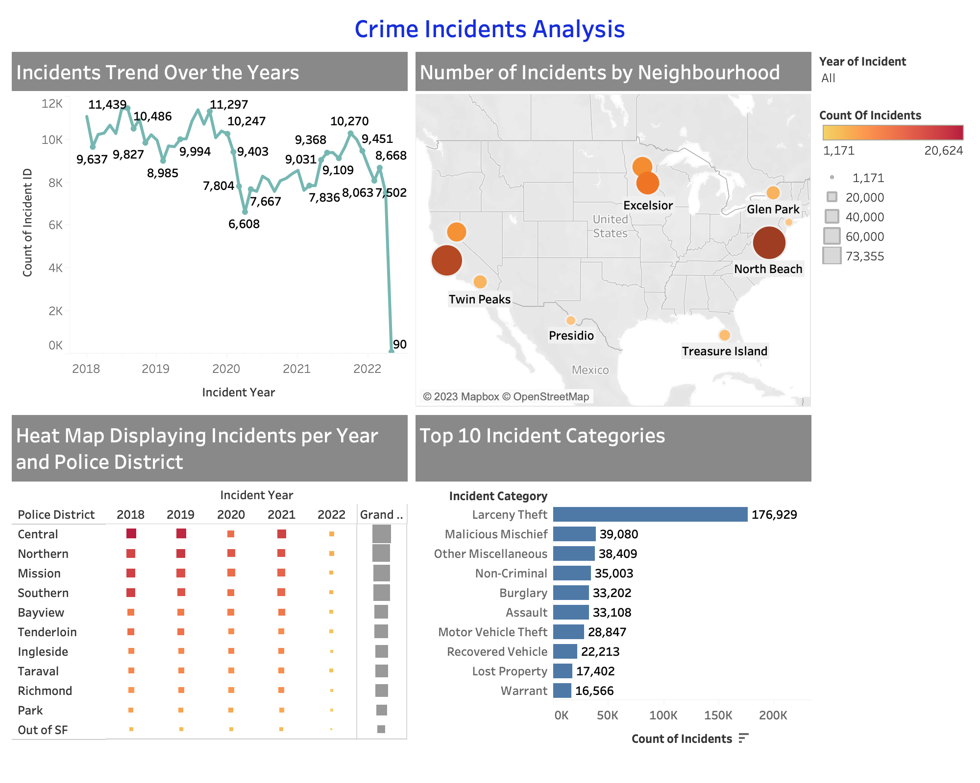

Slide 4
